Slide 1
School of Computer Science & Engineering
AI Application Development – IA2
AgroLedger

Slide 2
Team members & roles
TEAM MEMBER NAME | ROLE
NISHA YADAV | TEAM LEAD
SANJANA R | DEVELOPER
NAMEERA SANIYA | GITHUB/PRODUCT BUILD
RUHI SHARMA | DEVELOPMENT LEAD
MEGHANA U | TEST LEAD
SAGARIKA DS | CUSTOMER CONTACT LEAD
Notes:
Talk about how they are managing their documents, how google docs does automatic versioning
As them what they know about Android and IoS versions

Slide 3
Modified Problem Statement
Small-scale farmers are unable to prove the origin, quality, and authenticity of their agricultural produce.
Due to lack of transparency in the supply chain, buyers do not fully trust product claims, leading to lower prices and reduced income for farmers.
Notes:
Talk about how they are managing their documents, how google docs does automatic versioning
As them what they know about Android and IoS versions

Slide 4
User/ Customer Understanding
We interacted with small-scale farmers and local buyers to understand real-world challenges.
Key insights:
Buyers want proof of origin and quality
Farmers struggle to justify higher prices
Trust is the biggest gap in the supply chain
Users prefer simple and easy-to-use systems
Notes:
Talk about how they are managing their documents, how google docs does automatic versioning
As them what they know about Android and IoS versions

Slide 5
Our Solution
AgroLedger is a hybrid agricultural provenance system that enables:
Farmers to register product details digitally
Generation of QR codes for each batch
Buyers to verify product authenticity instantly
The system combines blockchain and cloud technologies to ensure both trust and accessibility.
Notes:
Only stress on the 1st sentence – the definition
Come back to the 2nd sentence in the end as part of revision

Slide 6
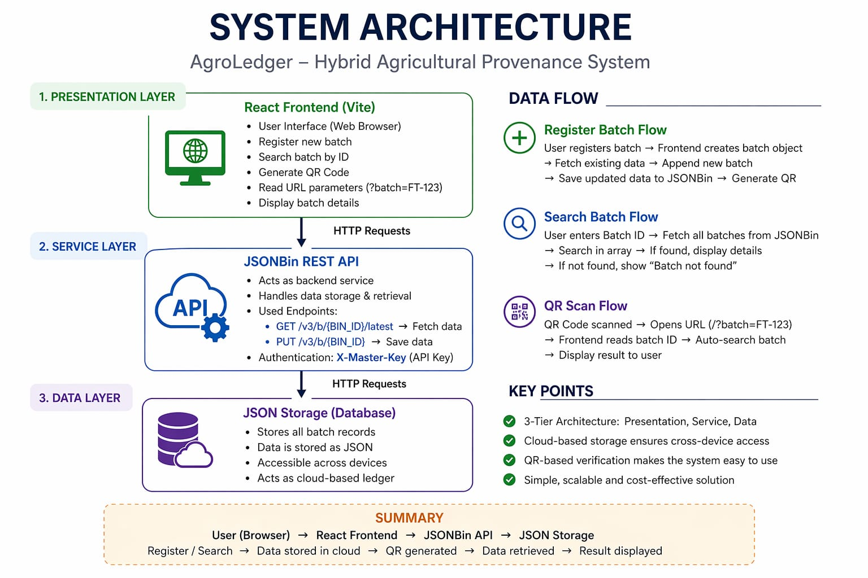
System Architecture

Slide 7
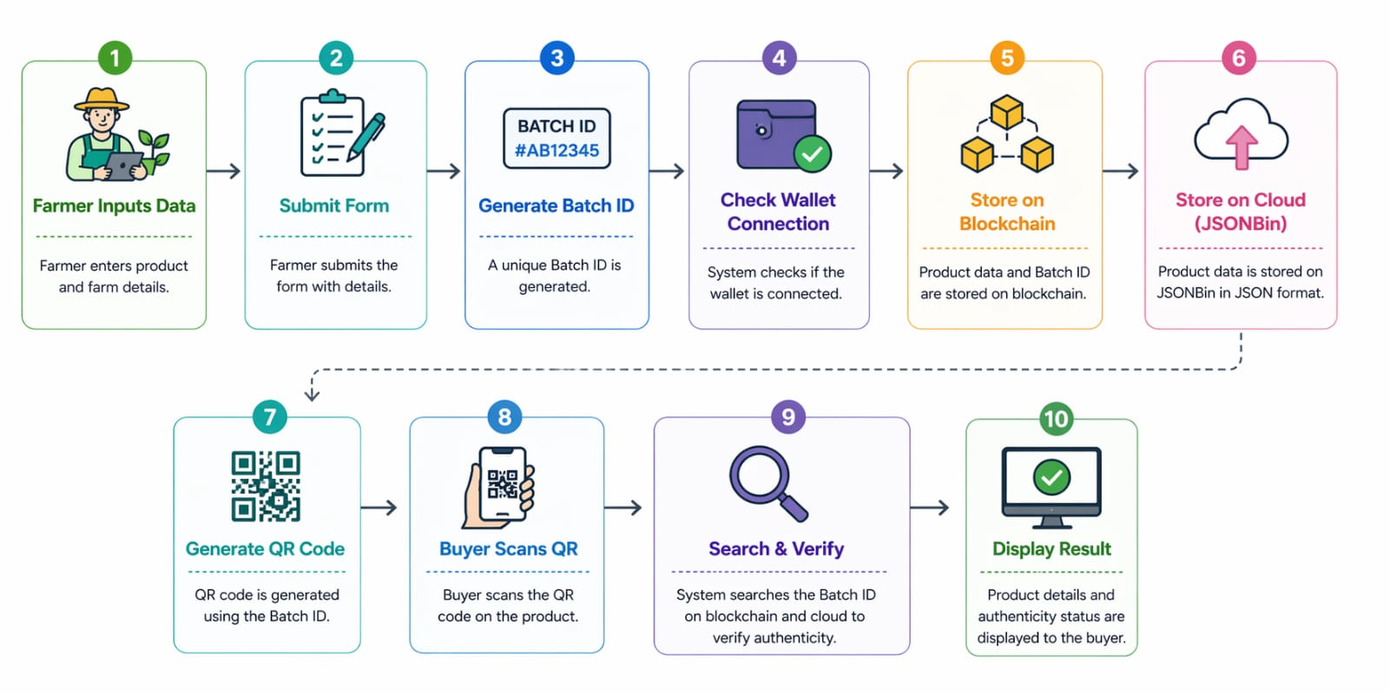
Full Product Flow
Notes:
Only stress on the 1st sentence – the definition
Come back to the 2nd sentence in the end as part of revision

Slide 8
Key Features
Hybrid storage (Blockchain + Cloud)
QR-based product verification
No login required for buyers
Cross-device accessibility
Simple interface for farmers
Real-time product tracking
Notes:
Only stress on the 1st sentence – the definition
Come back to the 2nd sentence in the end as part of revision

Slide 9
Use Cases & High level Requirements
UC1: Farmer Registers Batch Input: Crop details (name, location, date) Output: Unique Batch ID + QR Code generated
UC2: Buyer Verifies Product Input: QR code scan Output: Product details displayed (origin, quality, timeline)
UC3: Batch Search & Verification Input: Batch ID or QR link Output: Data retrieved from cloud and shown with status
UC4: Cross-Device Access Input: QR shared via link or WhatsApp Output: Buyer accesses product data instantly without login
Requirements document available on GitHub — includes Functional Requirements , Non-Functional Requirements (performance, cost, usability), and Acceptance Criteria for each feature.
Notes:
Only stress on the 1st sentence – the definition
Come back to the 2nd sentence in the end as part of revision

Slide 10
Proof of Concept (PoC) / Demo
Github: Github
Notes:
Only stress on the 1st sentence – the definition
Come back to the 2nd sentence in the end as part of revision

Slide 11
Conclusion
AgroLedger improves transparency in agricultural supply chains by enabling farmers to register produce and generate QR codes for verification.
It allows buyers to easily access product details, building trust and ensuring fair pricing.
The system is simple, low-cost, and accessible, making it suitable for real-world use.

